Slide 1

Information & communication technologies: A comprehensive overview
Course: Office and Web
University: USTHB – computer science engineering
Made by the following students of the C section: Rihane GHAZI, Djad Abdelhafid CHIBANI, Bouchra ZAIDI, Yasmine BELHEDID, Neil ISSOLAH

Slide 2
The content table:
Introduction
2. Information and Communication Technologies (ICT)
3. Technologies Related to ICT
3.1. Google Services
3.2. Microsoft tools
3.3. Git and GitHub
3.4. Cloud computing
3.5. Internet of things
3.6. Cybersecurity technologies
3.7. Artificial intelligence & Machine learning
3.8. Data analytics and Big Data
3.9. Networking technologies
3.10. Virtualization
3.11. Mobile technologies
3.12. Blockchain technology
3.13. Quantum computing
3.14. Voice and speech technologies
3.15. Robotics and automation
3.16. Augmented reality and Virtual reality
4. Conclusion

Slide 3
Introduction:
The historical evolution of Information and Communication Technologies (ICT) spans several decades, from the first electronic computers in the 1940s to today's rapid advancements in 5G, artificial intelligence, and IoT. Understanding ICT is crucial for computer science students, enhancing problem-solving skills, adaptability, and efficient communication. Proficiency in ICT principles prepares students for real-world applications and industry-standard practices, making them competitive and versatile in the evolving job market. The objectives of the report are to provide a comprehensive overview of ICT, explore major technologies, and emphasize their relevance to computer science education and professional development.

Slide 4


2. Information & communication technologies
2.2. Role in data communication & networking:
2.1. Definition of ICT:
Information and communication technologies (ICT) integrate telecommunications and computing, enabling efficient communication, data flow, and innovation across diverse platforms. This convergence plays a central role in modernizing information systems, influencing domains from software development to communication network establishment.
Information and communication technologies rely on standardized protocols, efficient data transmission, and robust network architectures to ensure seamless and secure data communication. These components form the foundation of interconnected ecosystems, promoting smooth information flow across platforms and applications.

Slide 5
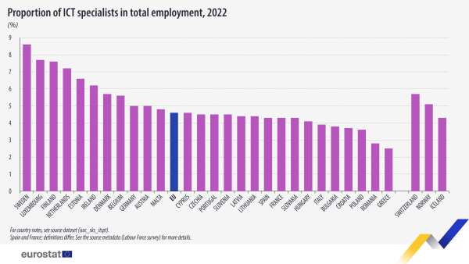
2. Information & communication technologies 2.3. Impact on industries:
ICT revolutionizes healthcare, finance, and education through electronic health records, online banking, and e-learning, driving efficiency and innovation across sectors. These innovations serve as cornerstones, fostering advancements in diverse industries.

Slide 6
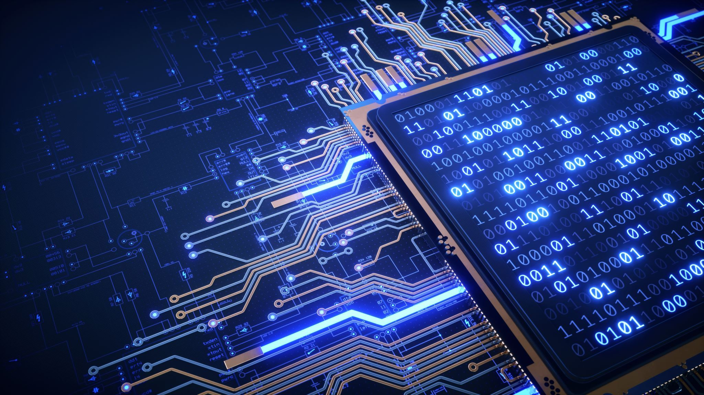




3. Technologies related to ICT 3.1. Google services:
Google Drive
Gmail
Google Docs
Google Docs enhances computer science project teamwork with real-time editing and commenting, fostering seamless collaboration. Version control ensures an organized project document, allowing cohesive work on coding and documentation.
Google Drive, a cloud storage service, ensures accessibility from any device and streamlines collaboration with real-time editing, version history tracking, enhancing efficiency for computer science projects.
Gmail streamlines email management with features like labels and automated filters, fostering an organized communication environment. Integrations with other Google services enhance productivity, crucial for effective coordination in computer science projects.

Slide 7

3. Technologies related to ICT 3.2. Microsoft tools:
Microsoft office suite
Microsoft teams
The Microsoft Office Suite integrates Word, Excel, and PowerPoint, enhancing workflow efficiency for documentation, data analysis, and impactful presentations. Word serves as a versatile word processor, Excel excels in spreadsheet functionalities, and PowerPoint is tailored for impactful presentations with multimedia elements.
Microsoft Teams serves as a robust collaboration hub, providing seamless communication with real-time chat, video meetings, and document sharing. Its integrated features, like collaborative editing and centralized access, foster efficient teamwork and successful project coordination for software development teams.

Slide 8


3. Technologies related to ICT 3.3. Git and GitHub:
Git
GitHub
Git, a decentralized version control system, enhances collaboration in Information and Communication Technologies through features like efficient branching and version history tracking. This presentation highlights its role in ensuring code integrity, facilitating parallel development, and improving collaborative software development across various industries.
GitHub, a web-based platform on Git, plays a crucial role in collaborative software development by offering version control and pull requests. Its versatility extends to Agile, open-source projects, and education, showcasing its significance in the dynamic landscape of information and communication technologies with evolving features and success stories.

Slide 9


3. Technologies related to ICT
3.4. Cloud computing:
3.5. Internet of things:
Cloud computing revolutionizes resource access by delivering on-demand services, including storage and processing power, over the internet. This scalable, flexible, and cost-effective model transforms IT infrastructure, enabling users to access and manage computing resources as needed, fostering a more agile and efficient approach through centralized services in remote data centers.
IoT interconnects devices with embedded sensors, actuators, and communication interfaces, fostering real-time data exchange and creating an efficient and responsive ecosystem. This connectivity allows devices, from smart home gadgets to industrial sensors, to coordinate actions, share data, and enhance automation, ultimately improving decision-making processes across diverse domains.

Slide 10

3. Technologies related to ICT 3.6. Cybersecurity:
Cybersecurity frameworks
Security tools
NIST and ISO/IEC 27001 cybersecurity frameworks serve as benchmarks for organizations, offering guidelines for effective practices. NIST emphasizes functions, while ISO/IEC 27001 focuses on Information Security Management Systems and continual improvement, collectively enhancing cybersecurity measures.
s.
Cybersecurity tools like Nessus and Qualys assess vulnerabilities, Metasploit and Burp Suite simulate attacks, and Snort and Splunk monitor for suspicious activities, collectively forming an essential arsenal for organizations to proactively defend against cyber threats.

Slide 11

3. Technologies related to ICT 3.7. Artificial Intelligence & Machine Learning:
IA & ML concepts
Applications
AI encompasses ML, a subset focused on developing algorithms for computers to learn and improve performance without explicit programming. ML, analyzing data and making predictions, contributes to innovations like recommendation systems, image recognition, and autonomous vehicles, collectively advancing human-like cognitive functions across industries.
AI and ML revolutionize industries through applications like NLP-driven chatbots, language translators, and image recognition. In healthcare, ML enables early disease detection, while in security systems, it enhances identity verification, showcasing their transformative impact on automating tasks and decision-making across diverse sectors.

Slide 12

3. Technologies related to ICT 3.8. Data analytics & Big data:
Big data concepts
Analytics tools
Handling large volumes of data poses challenges in security and scalability, leading to potential inaccuracies in data quality. Despite these hurdles, big data analytics offers significant opportunities for organizations to extract valuable insights, make informed decisions, and leverage technologies like machine learning for enhanced efficiency and innovation across diverse sectors.
Apache Hadoop and Apache Spark are pivotal tools in data analytics and big data processing. Hadoop excels in distributed storage and processing of large datasets, while Spark, building upon Hadoop, offers faster data processing and machine learning functionalities. Together, they form a robust foundation for efficient and scalable data processing in diverse analytical scenarios.

Slide 13

3. Technologies related to ICT 3.9. Networking technologies:
The advent of 5G networks revolutionizes telecommunications with unprecedented speed and low latency, transforming industries. Beyond enhancing consumer experiences, 5G fosters innovation in augmented reality, autonomous vehicles, and the Internet of Things, reshaping the digital landscape.
Software-Defined Networking
5G technology
SDN introduces a fundamental shift by separating the control and data planes, enabling centralized control through a software-based controller. This decoupling enhances network agility and programmability, as administrators can dynamically optimize the control plane without modifying individual network devices, marking a significant advancement in network architecture for increased flexibility and scalability.

Slide 14

3. Technologies related to ICT 3.10. Virtualization:
Citrix Virtual Apps and Desktops revolutionize traditional computing by delivering virtualized applications and desktop environments. Enhancing flexibility, security, and centralized management, these solutions streamline desktop delivery, reduce hardware dependencies, and foster a mobile and agile work environment, representing the evolution of modernized resource deployment in desktop virtualization.
Server virtualization
Desktop Virtualization
VMware and Hyper-V optimize server virtualization, with VMware's vSphere featuring vMotion and vSphere HA, and Microsoft's Hyper-V in Windows Server offering capabilities like Hyper-V Replica and cloud integration. Both technologies contribute to cost savings and streamlined IT management by consolidating multiple virtual machines on a single server in the dynamic computing landscape.

Slide 15
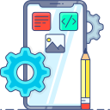
3. Technologies related to ICT 3.11. Mobile technologies:
Securing mobile applications is crucial due to widespread smartphone use and handling sensitive data. Developers must prioritize robust security measures, including encryption, to mitigate risks like data theft. As apps evolve with technologies, a comprehensive approach is essential for maintaining user trust and digital ecosystem integrity.
Mobile app development
Mobile security
In mobile app development, Android's open-source flexibility attracts a broad audience, while iOS prioritizes a seamless user experience and higher revenue potential. Android's wider market share contrasts with iOS's controlled environment, requiring developers to navigate platform differences for successful app adoption.

Slide 16

3. Technologies related to ICT 3.12. Blockchain technology:
Blockchain, beyond cryptocurrencies, excels in supply chain transparency and healthcare data security. It creates an immutable ledger in supply chains, reducing fraud and streamlining processes. In healthcare, it ensures patient data integrity and interoperability. These applications showcase blockchain's versatility in providing secure, transparent, and efficient solutions across industries.
Blockchain ensures secure, transparent transactions in decentralized blocks, forming an immutable record with cryptographic links. Its design eliminates central vulnerability, and consensus mechanisms reinforce transaction integrity. Beyond cryptocurrencies, blockchain offers an efficient, tamper-resistant method for secure transactions, meeting industries' trust and transparency needs.
Blockchain concepts
Applications

Slide 17

3. Technologies related to ICT 3.13. Quantum computing:
Quantum computing holds transformative potential in cryptography, optimization, and materials science, posing challenges in qubit stability and scalability. Its promise to reshape complex problem-solving across industries and scientific disciplines is contingent on overcoming these hurdles as research progresses.
Quantum computing, leveraging qubits' superposition and entanglement, promises revolutionary speed in solving specific problems like cryptography and materials science. This paradigm shift, still in its early stages, holds immense potential for transforming computation and problem-solving, presenting a new era in the computational landscape.
Quantum computing basics
Potential impact

Slide 18

3. Technologies related to ICT 3.14. Voice & speech technologies:
Siri and Alexa, advanced voice assistants, transform technology interactions with seamless user experiences and AI-driven capabilities. Siri excels in Apple devices, while Alexa, in Amazon Echo, extends to smart home control. Redefining interfaces, they shape future human-computer interaction for convenience and efficiency in digital environments.
Google Speech-to-Text and Amazon Polly transform spoken language into text and synthesized speech, using advanced machine learning and deep learning, respectively. They showcase the evolution of speech recognition and synthesis, providing versatile solutions for developers and businesses seeking robust speech capabilities in applications and services.
Speech recognition
Voice assistants

Slide 19

3. Technologies related to ICT 3.15. Robotics & Automation:
Industrial robots bring transformative efficiency to manufacturing by automating tasks like assembly and welding, reducing costs, and enhancing product consistency. With advanced sensors and precision controls, these robots contribute to workplace safety by handling hazardous operations. This integration aligns with Industry 4.0, marking a shift toward smart technologies that redefine industrial production and elevate productivity.
RPA utilizes software bots to automate repetitive tasks, reducing the workload on human employees and ensuring accuracy. Tools like UiPath and Automation Anywhere streamline data-related tasks and decision-making processes, enhancing efficiency. RPA's versatility across applications makes it a potent tool for organizations seeking productivity improvements without complex integrations.
Robotic process automation
Industrial robotics

Slide 20

3. Technologies related to ICT 3.16. Augmented Reality & Virtual Reality:
AR and VR transform gaming by providing immersive experiences, while education leverages them for interactive learning environments. In healthcare, these technologies aid training simulations, surgical planning, and therapeutic interventions, showcasing their versatility beyond entertainment, enhancing education, and improving healthcare practices through immersive experiences.
Augmented Reality (AR) enriches the real world by overlaying digital information, while Virtual Reality (VR) immerses users in synthetic environments via headsets. From gaming to healthcare, these technologies redefine digital interaction, creating immersive experiences that bridge the gap between the physical and virtual realms.
AR and VR concepts
Applications

Slide 21
4. Conclusion:
To sum up, Our exploration of Information and Communication Technologies (ICT) reveals a dynamic landscape shaping modern computing. Recognizing ICT's pivotal role in global information flow, we delved into diverse technologies, emphasizing their interconnected nature. This defines the present computing landscape and anticipates transformative changes. ICT acts as a catalyst for current progress and foreshadows future advancements, urging readers to explore emerging technologies, cybersecurity, and artificial intelligence. Embracing these topics allows individuals to actively contribute to the ongoing transformative journey of Information and Communication Technologies.

